Slide 1

District 10 4-H Foundation
Scholarship Workshop
Revised: Dec. 2023

Slide 2
Myths about Financial Aid
Myths:
  My parents make too much money, so I’ll never qualify.
  Only the top % of students with perfect GPAs get scholarships.
  Financial Aid is too competitive for the average student.
Truths:
  Every financial background can receive financial aid.
  Scholarships are not always awarded based solely on GPA.
  Many local scholarships will have a very small pool of applicants. Financial aid is a numbers game; the more applications you send out – the more opportunity for $$$.

Slide 3
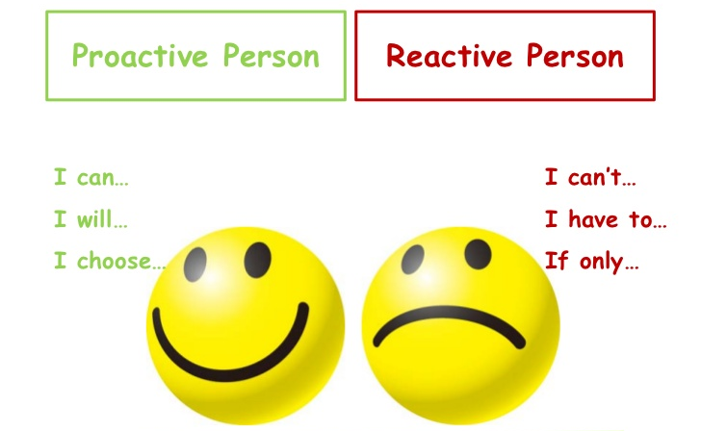
The mind frame for success…

Slide 4

Don’t get caught off guard!
Going to college can be a stressful ordeal for an unprepared student and their family.
Before you focus on paperwork, first
MAKE A PLAN.
  Set your own deadlines and have small goals through the application process.
Roadmap to this presentation:
  4-H Foundation Opportunity Scholarship Overview
  Written Application Tips
  Interview Preparation

Slide 5

Texas 4-H Foundation Opportunity Scholarship
Eligibility, Scholarships available, FAFSA & More!

Slide 6
Introduction
The scholarship program is overseen by the Texas 4-H Youth Development Foundation.
An estimated $2.8 million will be given at the Texas 4-H Roundup Scholarship Assembly.
Approximately 230 scholarships will be awarded in 2024.
4-H Scholarships are ACADEMIC SCHOLARSHIPS awarded based on academic record, 4-H experience, and financial need (certain scholarships).

Slide 7
Recent Program Changes
General Eligibility to apply is not limited to top ½ (50%) of class. Youth in the 3rd or 4th quartile of their class may apply. Some donors will still require the applicant to be in a certain percentage of class (Example: top 50%, top 10%, etc.) to receive their individual scholarship.
Members receiving a Terry Scholarship are NOT eligible to receive a Texas 4-H Opportunity Scholarship (same as past few years).
Will not be using CEA verification form. CEA’s will receive list of applicants submitted by deadline for approval/enrollment verification/eligibility.
Applicants invited to interview will do a “self-signup” for interview time (first come-first serve)
ACT/SAT not required again this year for the 4-H Opportunity Scholarship.
Collegiate Scholarships will not be awarded in 2024.

Slide 8
Scholarships Available
Baccalaureate
  Students pursuing a Bachelor of Science or Bachelor of Arts.
Technical
  Students pursuing a technical certification.
Courageous Heart
  For Baccalaureate or Technical applicants.
  4-H members that have overcome obstacles related to medical, family, and/or education.

Slide 9
General Eligibility Requirements
Current ACTIVE 4-H member and at least two of the three previous years.
Be a United States citizen.
Be a Texas resident.
Scheduled to graduate from a Texas High School (public, private, home) during 23-24 year.
Been accepted into a Texas College/University or technical school by the time of interview. NO OUT OF STATE SCHOOLS.

Slide 10
General Eligibility Requirements
Completed and passed all necessary standardized test(s)/requirements for graduation and met the entrance requirements for the college/university for which formal application has been made.
Submit a 2024 scholarship application
  Only required supplemental documents have been included – transcript, FAFSA, Courageous Heart letters (if applicable).
  DO NOT submit application before fall grades have been added to the transcript. (In most cases, not submitting in December as likely do not have updated transcript)
Application must be complete and correct
Once submitted, no updates allowed

Slide 11
2024 FAFSA CHANGE
The FAFSA will not open until December 31st this year.
The SAR reported (generated from FAFSA) will still be a requirement to submit Texas
4-H Opportunity Scholarships.
PLEASE watch studentaid.gov for updates and complete as soon as it opens, to assure that you have the SAR in time to submit the scholarship application.
If you start to run into delays receiving your SAR, stay in contact with your CEA. They may advise you to contact the Texas 4-H Foundation office.

Slide 12
Scholarships for 4-H Members
Deadlines & Important Dates:
Scholarship Application Opens: November 1st 2023
FASFA Opens for Applicants: December 31, 2023
Application Deadline: February 15th 2024 @ 11:59 PM
Interviews Selection Notification: April 2024
Interviews in College Station, TX: April 26th – April 27th 2024
Award Notifications: Early May 2024
Awards Assembly at State Roundup: June 4th – 6th, 2024
Dates in yellow are FIRM. If applicant does not meet the application deadline or is present for interview/banquet, they may not be eligible to receive the scholarship.

Slide 13
Additional Baccalaureate Eligibility
  Same General Eligibility Requirements covered above.
  Some scholarships WILL require applicants to be in the upper one-quarter (1/4) of his/her class.

Slide 14
Additional Baccalaureate Eligibility
Financial aid confirmation will only be collected just before the interview.
Houston Livestock Show and Rodeo Eligibility
  Confirmed Financial Aid and Houston Livestock Show and Rodeo Scholarships:
    A recipient of any Houston Livestock Show and Rodeo Scholarship may not receive more than $110,000 total from financial aid or any other scholarships and remain eligible to receive the Show scholarship. Applicants must list all financial aid and scholarships for which they have applied and the status of those awards as part of the application. If selected as a finalist for a scholarship, the applicant must verify all other financial aid and scholarships received. Other financial aid or scholarships received will be verified by submission of award letters from individual donors and financial aid offices of the college/university the recipient will attend. Awarding of scholarship and/or funds will not be disbursed without such verification.

Slide 15
Additional Technical Eligibility
Must not have plans to continue formal education at a Texas college and/or university after the completion of a technical program.

Slide 16
Additional Courageous Heart Eligibility
Courageous Heart applicants cannot be considered for other Texas 4-H Opportunity scholarships.
Have WRITTEN documentation of obstacles.
Include three letters of recommendation.
Complete the Courageous Heart Narrative.
Maximum Scholarship value is $5,000. Limited quantity of these awards given annually.

Slide 17
Reminders for 2024 Application
All applications must be submitted through the Texas 4-H Foundation Scholarship Portal.
Go through Texas 4-H Foundation website:
texas4hfoundation.org/what-we-do/
Select the scholarship type: Baccalaureate, Technical or Courageous Heart.
Then select “Apply” once on the desired page.

Slide 18
Items Needed to Complete Application
4-H record book(s) or participation information to help complete the scholarship application.
2024 Texas 4-H Opportunity Scholarship Application Guidelines. (Foundation Website)
Official high school transcript with either school seal or original signature of counselor/principal.
Free Application for Federal Student Aid (FAFSA) Student Aid Report (SAR).

Slide 19

4-H Scholarship Portal
It is important to use the email that you wish to receive all communications through.
DO NOT use an email that you will not have access to after you graduate.
All contact information should be the applicant’s information – NOT THE PARENT/GUARDIAN.

Slide 20
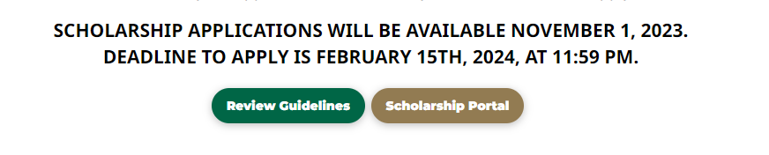
https://texas4hfoundation.org/types-of-scholarships/

Slide 21
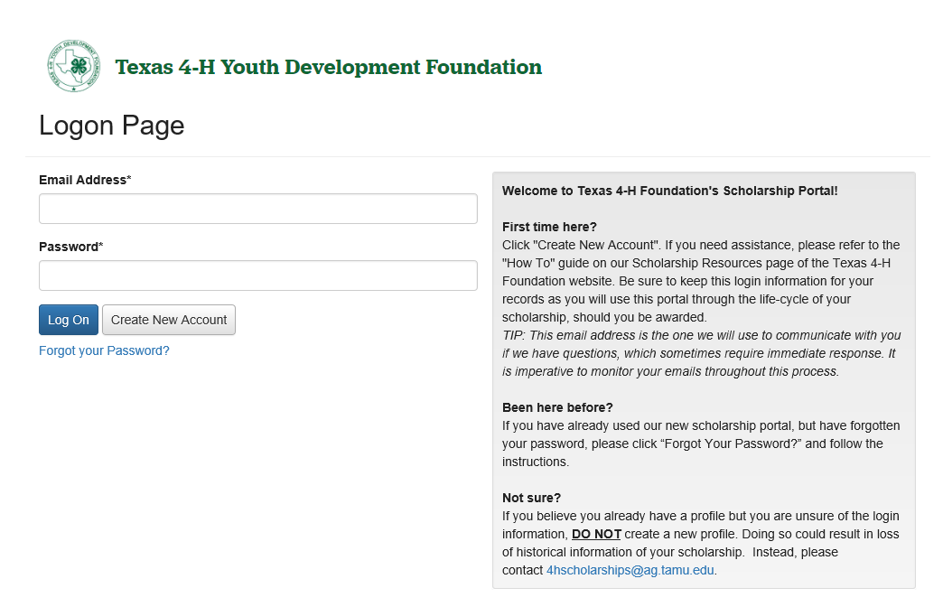
You must create an account in the Texas 4-H Foundation Scholarship Portal
Instructions

Slide 22
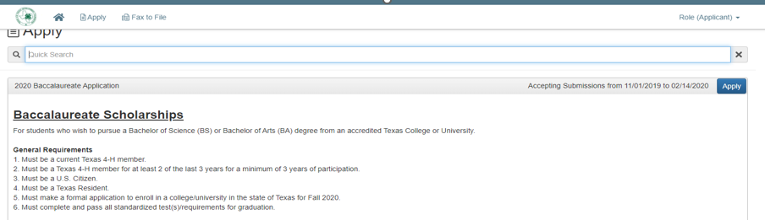
After creating an account and completing the contact information, you will be taken to the Applicant Dashboard.
Click the “Apply” button at the top of the page to view all available applications.

Slide 23
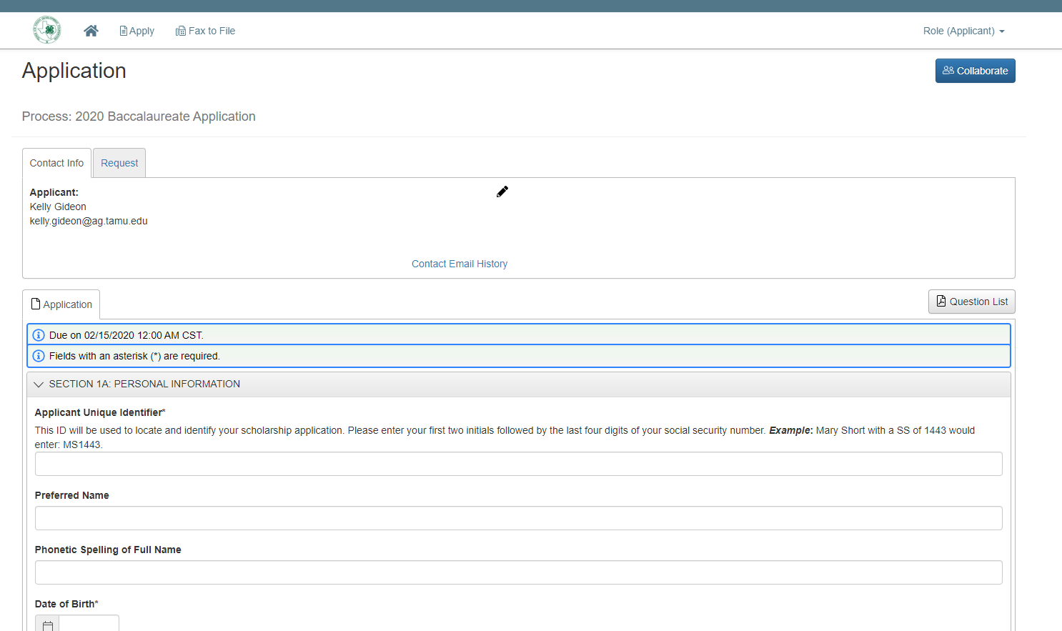
Collaborate Tool
Allows you to invite anyone (using their email address) to view and edit your application. Instructions are linked on the Foundation website under the “Apply” button.

Slide 24

Application Tips
Most of your points will come from your written application. Judges will determine if you’re a contender by what you write, not what you say.

Slide 25
Application Sections
SECTION 1A: Personal Information
SECTION 1B: Demographics
SECTION 1C: District & County Information
SECTION 2: College/University Information
SECTION 3: Livestock Show Participation
SECTION 4: Individual Scholastic Record
SECTION 5: Ranking & CPA Verification
SECTION 6: Financial Information
  Student Aid Report Upload
  Financial Narrative
SECTION 7: Written Application & Narratives
SECTION 8: Acknowledgement of Integrity

Slide 26
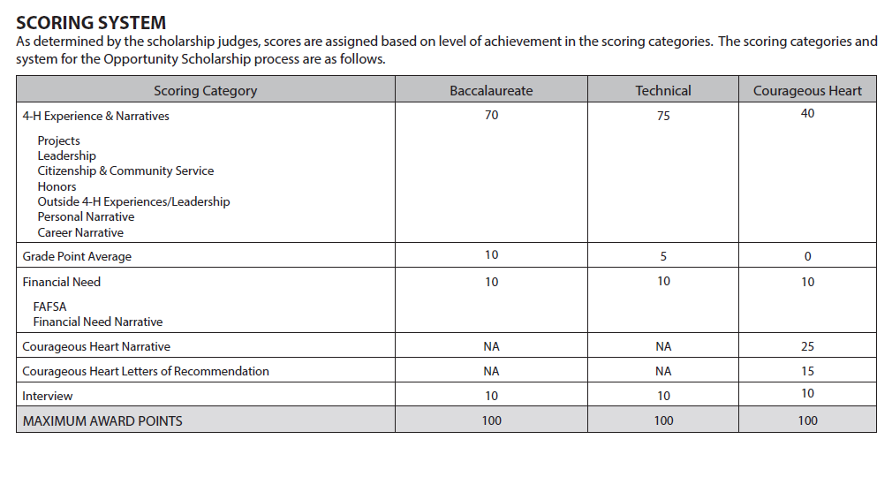
Foundation Scholarship Rubric
70% of your application points will come from your written application.

Slide 27
Written Application
Creating a well-reasoned, informative and well-written scholarship application is one of the things you can do to give you the edge you need.
Remember:
  Follow the Rules & read the
  guidelines
  Polish it up!
  Determine Priority

Slide 28
Section Breakdowns
Project Experiences:
  Section Description: List up to four (4) of your most significant 4-H projects throughout your entire 4-H career. Describe years involved, knowledge and skills gained, scope and activity related to projects, demonstrations, presentations, exhibits, workshops, tours, interviews, etc. Describe why these projects were important and significant and what impact your involvement provided you to have on other people. Put emphasis on the quality of your experience, rather than quantity. Please reference the level of participation/involvement as L=local, C=county, D=district, R=regional, S=state, N=national, and I=international.

Slide 29
Low Scoring Example
Animal Project 2010-2020
  Showed in 10 Stock Shows (C, D, S)
  Attended 5 workshops, 50+ project meetings, and 2 camps. (L, C, D, S)
  Learned about responsibility, time management and dependability.
Leadership Project 2013-2020
  Served as a Club Secretary, Treasurer, 2nd Vice, 1st Vice, President (2013-2020)
  Attended 200+ club meetings.
  Learned how to be a Project Manager, responsibility and leadership

Slide 30
Ways to Improve…
Animal Project 2010-2020 (10 years)
  Contests & Exhibitions of Project: Showed in 3 County Shows (C), 4 State Stock Shows (Includes HSLR, SALE, & FWSRR)
  Educational Activities: Participated in 50+ project meetings (L). Attended 5 Showmanship workshops (L2, C1, S2) and 2 Texas A&M Camps (S).
  Leadership in X Project: Served as a Livestock Ambassador (S) and accumulated 80 hours of service. Delivered 18 Animal Presentations (8L, 3C, 3D, 4S) and reached an audience of 350 youth.
  Knowledge Gained: Developed feeding rations, nutrition needs for large ruminants, how to identify signs of Clostridial Disease, etc. (Concrete examples of specifically what you learned. Should be advanced learning outcomes for your age group)
  Impact: Established a deep understanding of animal welfare and how it impacts our food supply, mentored 6 younger 4-H members in animal project, developed confidence in advocating for livestock industry. (Again, should be concrete impacts that do not affect JUST YOU, should be impacting others as well as your community.)

Slide 31
Format is UP TO YOU!
Animal Project 2010-2020 (10 years)
  Contests & Exhibitions of Project: Showed in 3 County Shows (C), 4 State Stock Shows (Includes HSLR, SALE, & FWSRR)
  Educational Activities: Participated in 50+ project meetings (L). Attended 5 Showmanship workshops (L2, C1, S2) and 2 Texas A&M Camps (S).
  Leadership in X Project: Served as a Livestock Ambassador (S) and accumulated 80 hours of service. Delivered 18 Animal Presentations (8L, 3C, 3D, 4S) and reached an audience of 350 youth.
  Knowledge Gained: Developed feeding rations, nutrition needs for large ruminants, how to identify signs of Clostridial Disease, etc.
  Impact: Established a deep understanding of animal welfare and how it impacts our food supply, mentored 6 younger 4-H members in animal project, developed confidence in advocating for livestock industry.
Animal Project 2010-2020 (10 Years)
Activity | Level | Knowledge/Skills | Impact
Stock Show Exhibitions (HSLR, SALE, FWSRR) | (C3, S4) | Gained experience in animal selection, process of preparing animal for show, and time management. | Exhibited sound, healthy well-groomed animals and promoted what the livestock industry is all about.
Project Meetings | (L50+) | Built all foundations of learning at project meetings such as project selection, nutrition for large ruminants, identifying common diseases and fundamentals of showmanship | Networked with adult leaders and senior members who helped me grow. I was able to channel that learning toward others by mentoring younger members
Texas A&M Camp | (S2) | Attended State Level camps taught by leading professionals in the animal husbandry industry. | Developed confidence in advocating for livestock industry after gaining firsthand knowledge from industry professionals.

Slide 32
Section Breakdowns
Leadership:
  Section Description: List up to twenty (20) major 4-H leadership roles throughout your 4-H career. Include volunteer, promotion, and elected/appointed leadership. List roles and responsibilities, years, and levels of involvement as L=local, C=county, D=district, R=regional, S=state, N=national, and I=international. Put emphasis on the quality of your experience, rather than quantity.

Slide 33
Low Scoring Example
Year | Leadership Role | Level of Involvement | Role, Responsibilities, Duties and/or accomplishments.
2013-2015 | Texas Horse Ambassador | (S) Appointed | Educated individuals, planned events, gave horse presentations.
2014-2015 | County Council Vice President | (C) Elected | Conducted meetings in President’s absence.
2013-2014 | County Council Vice President | (C) Elected | Conducted meetings in President’s absence.
DO NOT’s:
Copy/Paste role/responsibilities. You’re just telling us your job description, not what you actually did!
Leadership positions should be appropriate for senior members. Wearing your club shirt is not leadership anymore…
Do not be shackled by modesty. If you don’t elaborate, we cannot assume you did anything besides what is written.

Slide 34
Ways to Improve…
Year | Leadership Role | Level of Involvement | Role, Responsibilities, Duties and/or accomplishments.
2013-2015 | Texas Horse Ambassador | (S) Appointed | Educated (~400) individuals through horse presentations I developed and planned 5 educational Ambassador events.
2014-2015 | County Council Vice President | (C) Elected | Assisted the president in his duties, conducted meetings and helped plan our annual BBQ Plate fundraiser (Raised $400).
2013-2014 | County Council Vice President | (C) Elected | Assisted the president in his duties and conducted meetings in his absence. This year I planned all club educational programs.
DO’s:
Elaborate! Provide quantitative information so we understand the scope of your work.
Each experience should be unique. Alter it slightly.
Leadership work should be varied. Don’t forget to list VOLUNTEER leadership (Actions you took on: organizing a service event, mentoring a younger member etc.

Slide 35
Section Breakdowns
Community Service:
  Section Description: List up to fifteen (15) of your citizenship and community service activities. List activity, year, and your role in the activity (use Y=performed yourself, M=member of a group, P=provided primary leadership to the group). Describe why your citizenship and community service was important in these activities and what impact your involvement provided you to have on other people. Put emphasis on the quality of your experience, rather than quantity.

Slide 36
Low Scoring Example
Year | Activity | Role | Importance/Impact of Involvement
2015-2018 | Angel Ride Benefit Trail Ride Volunteer | (M) | Volunteered each year and raised money for sick babies. This event is a lot of fun because we get to ride bikes with our club.
2016 | Pillows for Patients | (M, P) | Our One-Day 4-H project created pillows for dialysis patients.
DO NOT’s:
Understand that Community Service is NOT about you. It’s about the community. Remember to make sure you know what the service event is all about. Who does it serve and more importantly WHY?
Vague impact statements leave us wondering, so what? How much did you raise, how many hours did you contribute, how many families did you impact?
Be varied in your role. As senior members, we should see some (P)’s where you are serving as the Primary Leader!

Slide 37
Ways to Improve…
Year | Activity | Role | Importance/Impact of Involvement
2015-2018 | Angel Ride Benefit Trail Ride Volunteer | (M) | Volunteered over 72 hours each year and raised over $20,ooo for babies stricken with Group B Strep disease.
2016 | Pillows for Patients | (M, P) | I coordinated our 2016 One-Day 4-H project and recruited 6 members to help create 72 pillows for dialysis patients. Pillows help them be more comfortable during their long dialysis treatments.
DO’s:
Understand your WHY! If you know how and why these activities impacted your community then you’ll have no problem with this section.
Have BALANCE. Not every entry should be a drive or a “bake and take”. Show community service projects that have you physically have ‘boots on the ground’ doing something or interacting with people to improve your community.
Be well rounded and avoid double dipping. Sometimes an activity can belong in multiple sections (and that’s ok!) but do not be redundant.

Slide 38
Section Breakdowns
Honors:
  Section Description: List up to four (4) of your most important honors received through 4-H. List the honor, year received, level of award (e.g. L=local, C=county, D=district, R=regional, S=state, N=national, and I=international), and why you consider the honors listed to be the most important (i.e. How did they contribute to and provide significance toward your personal development?).

Slide 39
Low Scoring Example
Year | Award | Level | Importance
2016 | 3rd Place Ind., National Western Roundup Horse Ed. Presentation | (N) | This award shows that my hard work and dedication paid off in public speaking.
2016 | 4-H Gold Star Award | (S) | Receiving the Gold Star Award fulfills my dream, and that all my work in 4-H was recognized..
DO NOT’s:
Give the “canned” answer to importance: “Shows my hard work and dedication paid off”. EVERY award should be a mark of hard work and dedication, but it sounds cliché and repetitive.
Foundation only asks you for 4 awards! Make sure you can deliver at least 4.

Slide 40
Ways to Improve…
Year | Award | Level | Importance
2016 | 3rd Place Ind., National Western Roundup Horse Ed. Presentation | (N) | This award was very unexpected. I’ve always struggled with my public speaking skills and dedicated many hours to this contest to make this possible.
2016 | 4-H Gold Star Award | (S) | Receiving the Gold Star Award fulfills one of my dreams. I’m honored that my countless project hours, long nights in the barn and setbacks in 4-H are now being celebrated with this prestigious award.
DO’s:
Be authentic! If you were surprised you won an award, were over the moon with 8th place or even felt that you could have improved, state that.
This section is NOT worth a ton of points so don’t treat it like a baseball card and rattle of stats. Make a little bit of effort and you will gain all the points for this section.

Slide 41
Section Breakdowns
Non 4-H Experiences:
  Section Description: OUTSIDE OF 4-H LEADERSHIP ACTIVITIES, HONORS, WORK EXPERIENCE, AND VOLUNTEER/COMMUNITY SERVICE: Describe how you spent time outside of your 4-H activities, why you devoted time to a particular activity, the impact the activity had on your personal development, and how it benefited other people. List leadership roles outside of 4-H (include school, church, other youth groups, etc).

Slide 42
Break it down…
Leadership
  (2016-2020) Student Council President – Served my class of 600 students by planning school wide events such as homecoming, Prom and our annual class trip.
Honors
  (2016-2020) National Honor Society Induction – Due to my continue work at maintain a 4.0 I was inducted into the National Honor Society.
Work Experience
  (2016-2018) Server at BurgerTown – Maintained a weekly work schedule that I balanced with school activities. Learned customer service skills, food handling and time management.
Community Service
  (2010-2020) Pictures with Santa – Every year for the past 10 years, I’ve volunteered with my church youth group to do “Pictures with Santa” at the Children’s Hospital. We volunteer 8 hours and take over 200 pictures every year.
Remember:
This section helps us recognize you as a well rounded individual. Your whole life should NOT just be 4-H!
Just like the other sections, ELABORATE the importance and impact. Tell the judges what you did, this should not be a laundry list acronyms!

Slide 43
Section Breakdowns
Personal Narrative
  Section Description: Write a personal narrative about yourself, highlighting any important facts and information you believe the selection committee should know when considering your application. This would include such things as your history in 4-H, any personal obstacles you have overcome, the greatest thing you will take from 4-H, and how 4-H will help you in the future.

Slide 44
Do’s & Don’ts
Remember:
This is the opportunity for the judge to get to KNOW YOU. Be personable, and share information about yourself, your family and the goals and aspirations you have had in your 4-H career.
Do not be afraid to you AUTHENTIC and share some of those painful or embarrassing moments. They may have bee the catalyst to where you are now!
The story reflects YOU, do not repeat your Project/Leadership/Community Service Experiences in a narrative form (We already covered that):
  WRONG: “In 2013, I competed in HLSR and placed 6th my pig. It was a wonderful experience and I had so much fun that the next year I competed in X, Y, Z…”
  RIGHT: “Over my 10 years in 4-H I’ve competed in over 50 shows, and those experience have taught me a lot about myself. I learned that as a young child I wasn’t very confident, but 4-H helped build my self esteem by…
4. This section is all about GROWTH. Where did you start? How have you ended? What will you take away? It should all come full circle.

Slide 45
Section Breakdowns
Career Exploration
Section Description: Describe how you have prepared yourself to have an awareness of and an understanding about career(s) applicable to the degree you wish to pursue. Type of information you may provide include:
  Visits to college/universities and conversations with personnel at those institutions.
  Investigations of job/career opportunities and availability
  Persons/experiences that have influenced you to pursue the degree/certification you have indicated.
  How you decided to pursue a technical certification versus baccalaureate or vice-versa.

Slide 46
Break it Down
Narrative Format:
Introduction – WHY do you want to pursue the career you have chosen? Does it come from a personal experience, an interest in a particular subject or something else? If you are vague or do not provide us a WHY, we are left to wonder if you truly understand the field of study you have chosen…
Body – WHAT have you done to learn more about this career/field of study? Tour campuses, interviews, career fairs, read articles, learned college expectations, degrees needed etc. If you don’t know yet what specifically you want to do, what options exist for people with your degree?
Conclusion – STATE the plan! What college have you chosen and why. What type of degree(s) must you pursue to make this dream happen? Who have you connected or networked with that can help mentor and guide you in your next step? Basically, tell us WHY SHOULD WE INVEST IN YOU?

Slide 47
Interview Preparation
Seal the deal!

Slide 48
Foundation Scholarship Interviews
Foundation Interviews are set for April 26-27, 2024.
Date/time will be scheduled by applicants in a first come/first serve fashion.
They do not hold any interviews outside of these dates. If you cannot come, you will forfeit your scholarship.
Give yourself plenty of travel time to College Station, TX.

Slide 49
Preparation is KEY
Prepare…
  How will the interview be conducted?
  Who will conduct the interview?
  What types of questions should I anticipate?
  How long do I have to interview?

Slide 50

Research, research, research!
Know your stuff!
  Be ready for 4-H SPECIFIC questions. Do you know the motto, what the H’s stand for, the pledge?
  Be ready for Record book specific questions! If you wrote it, you better know it!

Slide 51
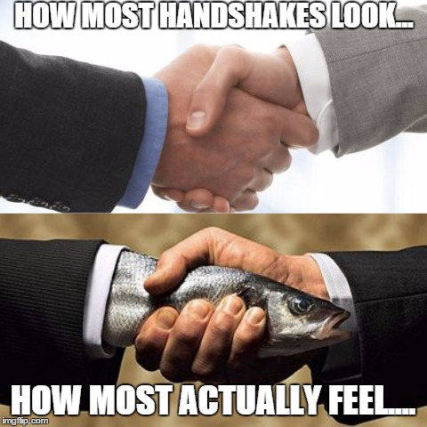
Make a GREAT First Impression
Arrive early.
Greet your interviewer(s)
  Art of the Handshake
  State your name (Try to remember theirs)
Practice good posture. Sit down, straight back and crossed legs/or together.

Slide 52

Answering Interview Questions
Remember the acronym “FACs”
Give them the “FACs”
FOCUSED answers that:
  Answer the ? You were given.
  Avoid derailing the subject.
AUTHENTIC answers that are:
  True to your experience.
  Honest and confident. Avoid memorizing everything!
CONCISE answers that are:
  Not too short, but not too long.
  End on definitive statements.

Slide 53


Your BODY is TALKING!
Great Body Language:
  Provide eye contact
  Smile
  Good posture
  ACTIVE Listening/Nodding
Body Language No-No’s:
  Slouching
  Looking ‘off’/No eye contact
  Playing/fidgeting with items
  Chewing Gum
  Mumbling

Slide 54

ABSOLUTE NO!!!!

Slide 55

Ending the Interview…
You know the interview is ending when the interviewers ask these most DREADED QUESTIONS…
  “Do you have any questions for us?”
  “Is there anything you’d like add?”
  “We’d like for you to tell us something about you that we didn’t ask.”

Slide 56

Ending the Interview…
DO NOT SAY…
  I don’t have any questions.
  There is nothing I’d like to add.
  I think you covered everything.
SAY OR ASK… (EXAMPLES)
  I am applying for other scholarships, do you have any suggestions on how I can improve my application?
  Actually, I did want to tell you about another experience that I think shows my qualifications.
  One last thing about myself, I am currently learning how to do _________ to make myself a better ________.

Slide 57

Seal the DEAL!
When you exit:
  DO NOT get up and leave.
Remember to:
  First, THANK your interviewers for their time and CONSIDERATION.
  Second, walk over and shake their hands again. If you remember their names say “Thank you Mr./Ms. ____ for your time.” Leaves a great impression!
  Then you may exit!!!

Slide 58
Questions?

